Slide 1
Damage Detection of Structures using AI
Guide: Prof. Nilanjan Mallik
Team Members:
Jadav Anand (17135044)
Joel Joseph (17135047)
Nasu Avinash (17135057)
Roshan Roy (17135074)
Velaga Girish (17135093)

Slide 2
Damage Detection
Damage
Prognosis
Condition
Monitoring
Structural
Health
Monitoring
Non
Destructive
Testing
Statistical
Process
Control
Health and
Usage
Monitoring
System
Damage Detection Disciplines

Slide 3
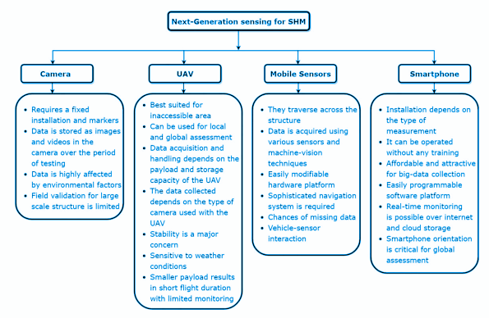
Smart Sensing Technologies:
Key findings of various next‐generation sensing technologies

Slide 4
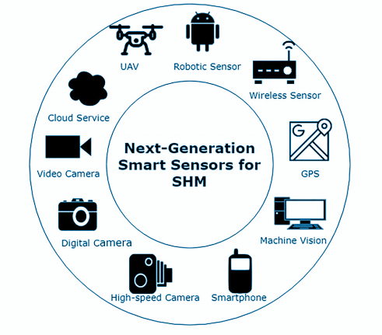
Smart Sensing Technologies:
A schematic of various next‐generation sensing technology used in the Structural Health Monitoring.

Slide 5
Abstract
Damage Detection comes under the area of Structural Health Monitoring(SHM). We intend to find out information about cracks in metallic structures after the application of changing load. In our project we intend to find the following info about the cracks:
Presence
Location
Severity (Quantification)
We intend to collect the data from experimentation under laboratory conditions. We take a standard rod, create a notch and create a crack using the fatigue machine available in the lab.
We then intend to collect as much data as possible regarding the correlation between data from the sensor and the known observation regarding the cracks. We intend here to use optical fiber sensors for our purpose.

Slide 6
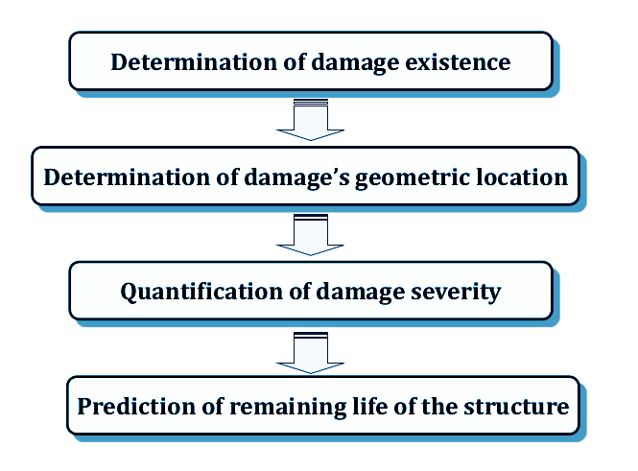
Introduction:
Structural health monitoring (SHM) refers to the process of implementing a damage detection and characterization strategy for engineering structures such as bridges and buildings.

Slide 7
Types of detection under SHM:
Visual Inspection - fully experience based subjective evaluation.
Non-destructive Testing (NDT) - use of various technologies done by individuals with a high degree of technical knowledge
Our experiment comes under Non destructive testing(NDT).
Pre-Experimental Preparation:
Materials :
Aluminium rods of various sizes are collected. Three optical fiber strips of one-third, two-third and full length are mounted on the top surface of the beams. A second series of experiments concerning concrete rods will also be done after the aluminium rods.

Slide 8
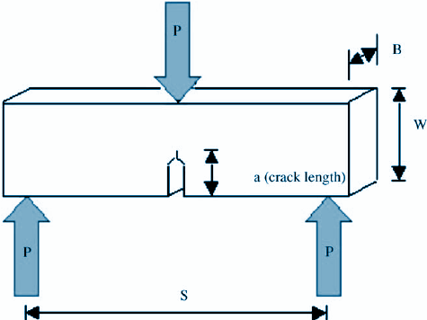
Creating Notch:
Notch is required to create cracks. In accordance with the European Code of Practice for Creep Crack Initiation and Growth Testing of Industrially Relevant Specimens, we chose Single Edge Notched Bend model for creating notches in our specimens.

Slide 9
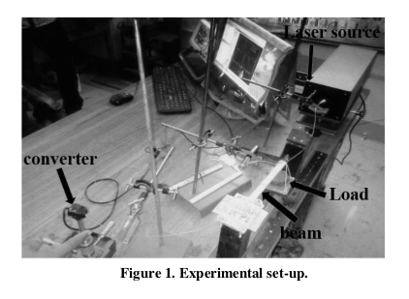
Experimental Setup:
The beam is loaded like a cantilever beam with a free end and other end attached to the support. A load is put on the free end.

Slide 10
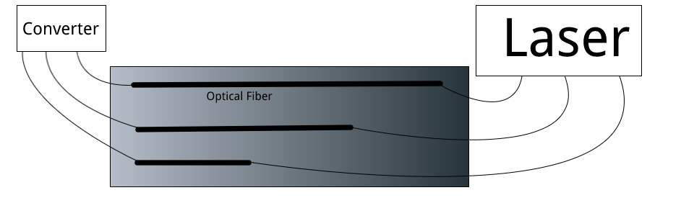
Electrical converter and Laser connected to the Optical Fiber Sensors on top of the specimen (notch not shown).
It is assumed that three fibers of different lengths will give us more information about the crack than that obtained from a single one.

Slide 11
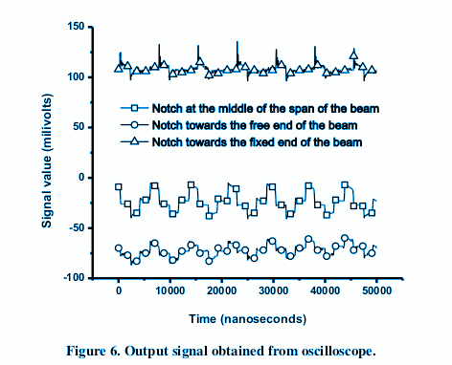
Data Collection:
Varying loads are applied starting from zero, and the signals are recorded for each of them for 5 seconds. The signal amplitude is collected each 100 microseconds.

Slide 12
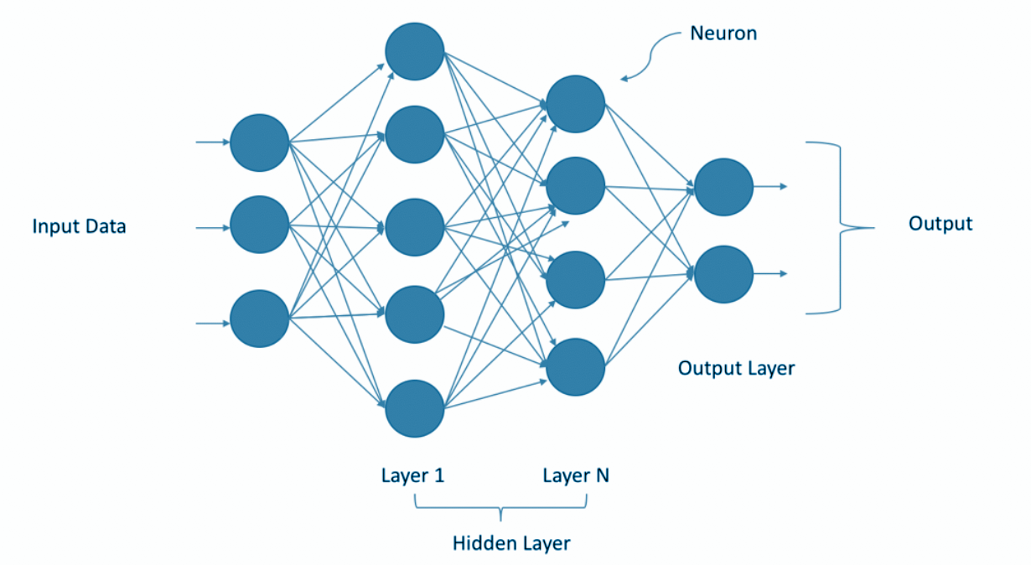
Function Approximator:
Function approximation is a technique for estimating an unknown underlying function using historical or available observations from a particular domain.

Slide 13
Results:
The output layer has 4 neurons corresponding to:
Detecting existence of damage. => 0 (no damage) or 1 (presence of damage)
Location of the crack. => Number between 0 and 1. (depicting the ratio of the location of crack to the total length of the specimen)
Depth of crack => Number between 0 and 1. (depicting ratio between depth of crack and total depth of specimen)
Average width of crack => Number between 0 and 1. (depicting ratio between average width of crack and total length of specimen)

Slide 14
Conclusions and Future Scope:
We were unable to conduct experiments and collect data due to the lockdown. Our report shows how damage detection can be done using simple fiber optic sensors and neural network algorithms. Depending on the experimental experience we intend to expand the scope of this project and work on actual buildings, with the real time data processed and sent to a smartphone (data about the strain, reliability and life). This will include our project under the domain of Smart Sensors for Structural Health Monitoring and IoT, and will be able to publish our work in journals of this kind.

Slide 15
Structural Health Monitoring using Smart Sensing and Artificial Intelligence:
Sensors:
Incidents such as building and bridge collapse are on rise in many parts of the world without little apparent warning.The sensors are very important to know the state of the health of the structures and technologies are like human brains to analyze the abnormal situation.
Characteristics of Sensors for Monitoring Health of Structures:
Range
Sensitivity
Accuracy
Stability
Repeatability
Static and dynamic characteristics
Energy Harvesting
Compensation due to change of temperature and other environmental parameters

Slide 16
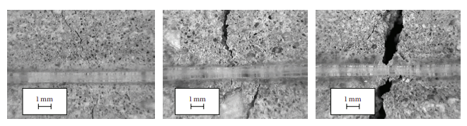
Optical Fibre Sensor:
The advantages of optical fibre sensing in engineering structures are well known and these include their insensitivity to electromagnetic radiation (especially in the vicinity of power generators in construction sites), being spark-free, intrinsically safe, non-conductive and
lightweight, and also their suitability for embedding into structures.

Slide 17
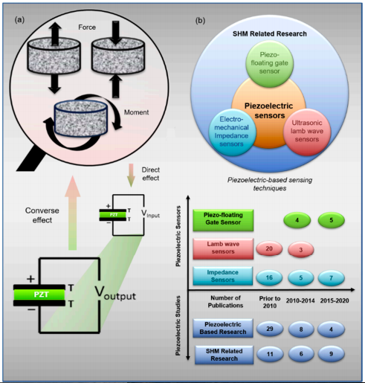
Piezoelectric Sensors:
In general, piezoelectricity implies the production of an electrical charge from a piezoelectric material when stressed mechanically. A reverse mechanism is also true. From figure the piezoelectric sensing process, utilizing the direct or inverse response of the piezoelectric effect to monitor structures. In this context, piezoelectric materials have been used in different sensing devices as actuators, sensors, or both.

Slide 18
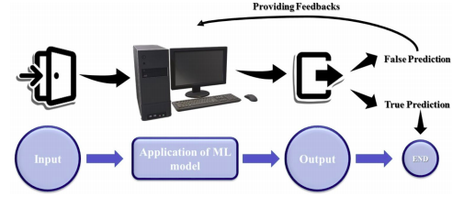
Machine Learning
Applications of Machine Learning (ML) algorithms in Structural Health Monitoring (SHM) have become of great interest in recent years owing to their superior ability to detect damage. ML can efficiently perform several analyses of clustering, regression and classification of damage in diverse structures, including bridges, buildings, dams, tunnels, wind turbines, etc. The diverse ML algorithms used in this domain have been classified into two major subfields: vibration-based SHM and image-based SHM.

Slide 19
Applications:
Bridge Health Monitoring (BHM):
BHM is the application of SHM and inspection techniques to bridge structures. Causes of degradation of bridge structures include materials aging , corrosion of metals and structural supports , mechanical overloading and other damage mechanisms . Bridge Health Monitoring (BHM) consists of collecting quantitative data from various sensors located within or on the surface of the structure.
Building Health Monitoring (BUHM):
Recently, experts have introduced ML algorithms to monitor the condition of high-rise buildings considering their proven effectiveness in other fields.
Wind Turbine Health Monitoring (WTHM):
Different problems faced by WTB during their lifecycle, and methods used to detect damage in WT, including acoustic emission event detection, thermal imaging, ultrasonic methods, model based approaches, fiber optics, laser doppler vibrometer, electrical resistance-based damage detection, strain memory alloy, X-radioscopy, eddy current and other methods have been reported. Accordingly, big data has accumulated.

Slide 20
References:
Structural Health Monitoring: research and practice, Conference Paper, Andrea Enrico Del Grosso
European Code of Practice for Creep Crack Initiation and Growth Testing of Industrially Relevant Specimens,
B. Dogan, U. Ceyhan, K. M. Nikbin, B. Petrovski, l and D. W. Dean, Journal of ASTM International, February 2006
Damage detection in composites using optical fibre sensors, N Takeda, Y Okabe, and T Mizutani, DOI: 10.1243/09544100JAERO148
Quantification of cracks in reinforced concrete structures using distributed fibre optic sensors, 9th European
Workshop on Structural Health Monitoring
Use of optical fibre for damage and strain detection in composite materials, S. R. WAITE and R. P. TA TAM
Presentation on Structural Health Monitoring, IIT Kanpur
Structural Health Monitoring, Wikipedia
Machine Learning Algorithms in Civil Structural Health Monitoring: A Systematic Review (2020), Springer
Piezoelectric Sensing Techniques in Structural Health Monitoring: A State-of-the-Art Review. Sensors 2020

Slide 21


